Slide 1
多项式
By 自为风月马前卒

Slide 2
要讲的东西
FFT
NTT+任意模数NTT
多项式逆元
多项式除法
多项式牛顿迭代法
多项式对数
多项式指数函数
多项式幂函数
多项式三角函数
多项式多点求值
多项式快速插值

Slide 3

基本定义
多项式
“在数学中，由若干个单项式相加组成的代数式叫做多项式”
多项式乘法
系数表示下的多项式乘法：对应系数分别相乘
点值表示下的多项式乘法：对于相同的x，将y相同

Slide 4
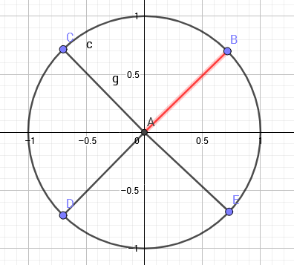
FFT
直接通过系数表示法或者点值表示法做多项式乘法的复杂度都是N^2的
通过单位根可以优化为NlogN
单位根：在复平面上，以原点为圆心，1为半径作圆，所得的圆叫单位圆。以圆点为起点，圆的n等分点为终点，做n个向量，设幅角为正且最小的向量对应的复数为ωn，称为n次单位根。

Slide 5



单位根的性质
欧拉公式
性质1
性质2

Slide 6

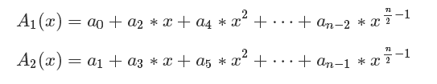

快速傅里叶变换(DFT)
设多项式
将其下标按照奇偶性分类
设

Slide 7
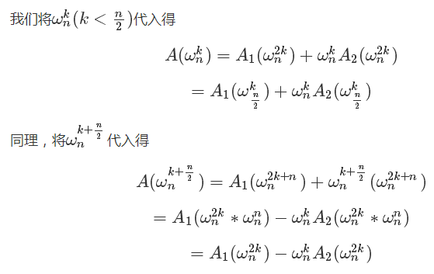
快速傅里叶变换(DFT)
不难发现A1与A2只有常数项不同
因此我们可以通过分治的方法解决这件事

Slide 8
快速傅里叶逆变换(IDFT)
将 带入后对所有点值除以N即可

Slide 9
代码实现
// luogu-judger-enable-o2
// luogu-judger-enable-o2
#include<cstdio>
#include<algorithm>
#include<cmath>
#define Pi acos(-1)
#define getchar() (p1 == p2 && (p2 = (p1 = buf) + fread(buf, 1, 1 << 21, stdin), p1 == p2) ? EOF : *p1++)
using namespace std;
const int MAXN = 4 * 1e6 + 10;
char buf[1 << 21], *p1 = buf, *p2 = buf;
char obuf[1<<24], *O=obuf;
void print(int x) {
if(x > 9) print(x / 10);
*O++ = x % 10 + '0';
}
inline int read() {
char c = getchar(); int x = 0, f = 1;
while(c < '0' || c > '9') {if(c == '-') f = -1; c = getchar();}
while(c >= '0' && c <= '9') x = x * 10 + c - '0', c = getchar();
return x * f;
}
int N, M, limit = 1, L;
struct complex {
double x, y;
complex(double xx = 0, double yy = 0) {x = xx, y = yy;}
complex operator + (const complex &rhs) {
return complex(x + rhs.x, y + rhs.y);
}
complex operator - (const complex &rhs) {
return complex(x - rhs.x, y - rhs.y);
}
complex operator * (const complex &rhs) {
return complex(x * rhs.x - y * rhs.y, x * rhs.y + y * rhs.x);
}
}a[MAXN], b[MAXN];
int r[MAXN];
void FFT(complex *A, int type) {
for(int i = 0; i < limit; i++)
if(i < r[i]) swap(A[i], A[r[i]]);
for(int mid = 1; mid < limit; mid <<= 1) {
complex Wn = complex(cos(Pi / mid), type * sin(Pi / mid));
for(int j = 0; j < limit; j += mid << 1) {
complex w = complex(1, 0);
for(int k = 0; k < mid; k++, w = w * Wn) {
complex x = A[j + k], y = w * A[j + k +mid];
A[j + k] = x + y,
A[j + k + mid] = x - y;
}
}
}
}
int main() {
#ifdef WIN32
freopen("a.in", "r", stdin);
#endif
N = read(); M = read();
for(int i = 0; i <= N; i++) a[i].x = read();
for(int i = 0; i <= M; i++) b[i].x = read();
while(limit <= N + M)
limit <<= 1, L++;
for(int i = 0; i <= limit; i++)
r[i] = (r[i >> 1] >> 1) | ((i & 1) << (L - 1));
FFT(a, 1);FFT(b, 1);
for(int i = 0; i < limit; i++) a[i] = a[i] * b[i];
FFT(a, -1);
for(int i = 0; i <= N + M; i++)
print((int(a[i].x / limit + 0.5))), *O ++ = ' ';
fwrite(obuf, O-obuf, 1 , stdout);
return 0;
}

Slide 10

快速数论变换NTT
优点：比FFT快
实现：将单位根替换为原根即可
具体来说：
在这里我们要求P为素数且N为P-1的因子
在具体实现时，P常选取998244353，它的原根G为3

Slide 11
代码实现
// luogu-judger-enable-o2
// luogu-judger-enable-o2
#include<cstdio>
#include<cstring>
#include<algorithm>
#define getchar() (p1 == p2 && (p2 = (p1 = buf) + fread(buf, 1, 1<<21, stdin), p1 == p2) ? EOF : *p1++)
#define swap(x,y) (x ^= y, y ^= x, x ^= y)
#define mul(a, b) 1ll * a * b % P
#define add(a, b) (a + b >= P ? a + b - P : a + b)
#define dec(a, b) (a - b < 0 ? a - b + P : a - b)
#define rg register
using namespace std;
const int MAXN = 4 * 1e6, P = 998244353, Gi = 3;
char buf[1<<21], *p1 = buf, *p2 = buf;
inline int read() {
char c = getchar(); int x = 0, f = 1;
while(c < '0' || c > '9') {if(c == '-') f = -1; c = getchar();}
while(c >= '0' && c <= '9') x = x * 10 + c - '0', c = getchar();
return x * f;
}
char obuf[1<<24], *O=obuf;
void print(int x) {
if(x > 9) print(x / 10);
*O++= x % 10 + '0';
}
inline int fastpow(int a, int k) {
int base = 1;
while(k) {
if(k & 1) base = mul(a, base);
a = mul(a, a); k >>= 1;
}
return base % P;
}
int N, r[MAXN], A[MAXN], B[MAXN], Og[MAXN], F[MAXN], Q[MAXN], G[MAXN], R[MAXN];
inline void NTT(int *A, int type, int len) {
int limit = 1, L = 0;
while(limit < len) limit <<= 1, L++;
for(rg int i = 0; i < limit; i++) r[i] = (r[i >> 1] >> 1) | ((i & 1) << (L - 1));
for(rg int i = 0; i < limit; i++) if(i < r[i]) swap(A[i], A[r[i]]);
for(rg int mid = 1; mid < limit; mid <<= 1) {
int R = mid << 1;
int W = fastpow(Gi, (P - 1) / R); Og[0] = 1;
for(rg int j = 1; j < mid; j++) Og[j] = mul(Og[j - 1], W);
for(rg int j = 0; j < limit; j += R) {
for(rg int k = 0; k < mid; k++) {
const int x = A[j + k], y = mul(Og[k], A[j + k + mid]);
A[j + k] = add(x, y), A[j + k + mid] = dec(x, y);
}
}
}
if(type == -1) {
std::reverse(&A[1], &A[limit]);
for(int i = 0, inv = fastpow(len , P - 2); i < limit; i++)
A[i] = 1ll * A[i] * inv % P;
}
}
void Inv(int *a, int *b, int len) {// a要求的多项式 b逆元 len：要求的逆元的长度
if(len == 1) {
b[0] = fastpow(a[0], P - 2);
return ;
}
Inv(a, b, len >> 1);
for(rg int i = 0; i < len; i++) A[i] = a[i], B[i] = b[i];
NTT(A, 1, len << 1); NTT(B, 1, len << 1);
for(rg int i = 0; i < (len << 1); i++) A[i] = mul(mul(A[i], B[i]), B[i]) ;
NTT(A, -1, len << 1);
for(rg int i = 0; i < len; i++) b[i] = (1ll * (b[i] << 1) % P + P - A[i] ) % P;
}
void Mul(int *a, int *b, int *c, int N) {
int len;
for(len = 1; len < N; len <<= 1);
NTT(a, 1, len); NTT(b, 1, len);
for(int i = 0; i < len; i++) c[i] = 1ll * a[i] * b[i] % P;
NTT(c, -1, len);
}
int main() {
#ifdef WIN32
freopen("a.in","r",stdin);
#endif
int N = read(), M = read();
for(int i = 0; i <= N; i++) F[i] = read();
for(int i = 0; i <= M; i++) G[i] = read();
/*reverse(F, F + N + 1); reverse(G, G + M + 1);*/
Mul(F, G, R, N + M + 1);
for(int i = 0; i <= N + M; i++) print(R[i]), *O++ = ' ';
fwrite(obuf, O-obuf, 1 , stdout);
return 0;
}

Slide 12
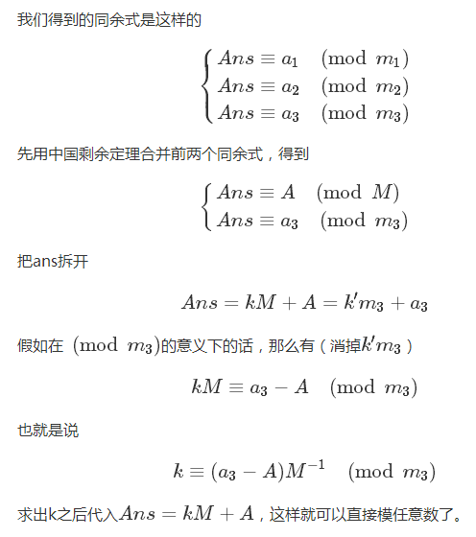
任意模数NTT
直接中国剩余定理合并即可

Slide 13
代码实现
// luogu-judger-enable-o2
// luogu-judger-enable-o2
#include<cstdio>
#include<algorithm>
#include<cstring>
#define swap(x,y) x ^= y, y ^= x, x ^= y
#define LL long long
const int MAXN = 3 * 1e6 + 10;
using namespace std;
inline int read() {
char c = getchar(); int x = 0, f = 1;
while(c < '0' || c > '9') {if(c == '-') f = -1; c = getchar();}
while(c >= '0' && c <= '9') x = x * 10 + c - '0', c = getchar();
return x * f;
}
const int P1 = 469762049, P2 = 998244353, P3 = 1004535809, g = 3;
const LL PP = 1ll * P1 * P2;
int N, M, P, limit = 1, L;
int A[MAXN], B[MAXN], C[MAXN], D[MAXN], Ans[3][MAXN], r[MAXN];
LL fastmul(LL a, LL b, LL mod) {
a %= mod, b %= mod;
return ((a * b - (LL)((LL)((long double)a / mod * b + 1e-3) * mod)) % mod + mod) % mod;
}
int fastpow(int a, int p, int mod) {
int base = 1;
while(p) {
if(p & 1) base = 1ll * a * base % mod;
a = 1ll * a * a % mod; p >>= 1;
}
return base % mod;
}
void NTT(int *A, const int n, const int type, const int mod) {
for(int i = 0; i < n; i++)
if(i < r[i]) swap(A[i], A[r[i]]);
for(int mid = 1; mid < n; mid <<= 1) {
int W = fastpow(type == 1 ? g : fastpow(g, mod - 2, mod) , (mod - 1) / (mid << 1), mod);
for(int j = 0; j < n; j += (mid << 1)) {
int w = 1;
for(int k = 0; k <mid; k++, w = 1ll * w * W % mod) {
int x = A[j + k], y = 1ll * w * A[j + k + mid] % mod;
A[j + k] = (x + y) % mod,
A[j + k + mid] = (x - y + mod) % mod;
}
}
}
if(type == -1) {
int inv = fastpow(n, mod - 2, mod);
for(int i = 0; i < n; i++)
A[i] = 1ll * A[i] * inv % mod;
}
}
void solve(int opt, int mod) {
memset(C, 0, sizeof(C)); memset(D, 0, sizeof(D));
copy(A, A + N + 1, C); copy(B, B + M + 1, D);
NTT(C, limit, 1, mod); NTT(D, limit, 1, mod);
for(int i = 0; i <= limit; i++) Ans[opt][i] = 1ll * C[i] * D[i] % mod;
NTT(Ans[opt], limit, -1, mod);
}
int main() {
#ifdef WIN32
freopen("a.in", "r", stdin);
#endif
N = read(), M = read(), P = read();
for(int i = 0; i <= N; i++) A[i] = read();
for(int i = 0; i <= M; i++) B[i] = read();
while(limit <= N + M) limit <<= 1, L++;
for(int i = 0; i <= limit; i++) r[i] = (r[i >> 1] >> 1) | ((i & 1) << (L - 1));
solve(0, P1);
solve(1, P2);
solve(2, P3);
for(int i = 0; i <= N + M; i++) {
LL A = (fastmul(1ll * Ans[0][i] * P2 % PP, fastpow(P2 % P1, P1 - 2, P1), PP) +
fastmul(1ll * Ans[1][i] * P1 % PP, fastpow(P1 % P2, P2 - 2, P2), PP) ) % PP;
LL K = ((Ans[2][i] - A) % P3 + P3) % P3 * fastpow(PP % P3, P3 - 2, P3) % P3;
printf("%d ",(A % P + ((K % P) * (PP % P)) % P ) % P);
}
return 0;
}

Slide 14
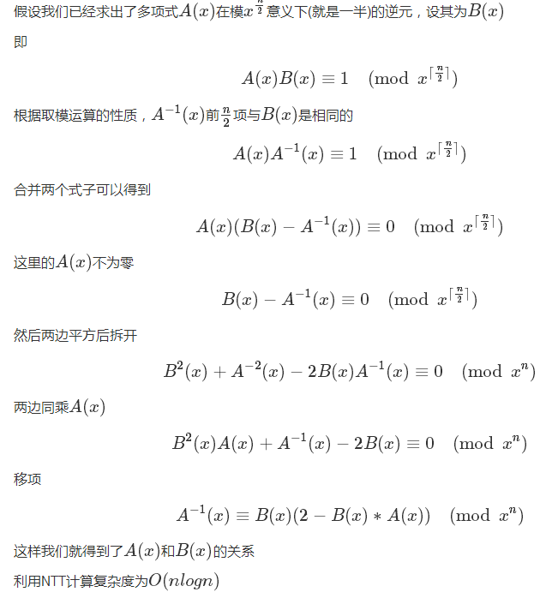
多项式求逆元

Slide 15
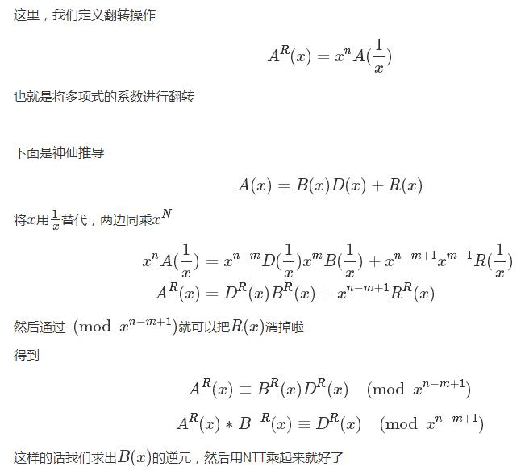
多项式除法

Slide 16
前方高能

Slide 17
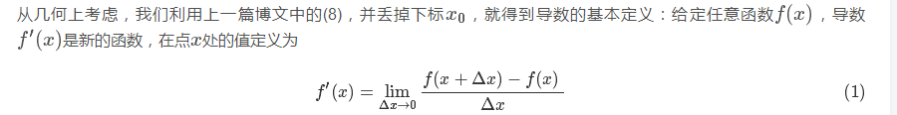
导数
一阶导数：斜率
二阶导数：凹凸性

Slide 18
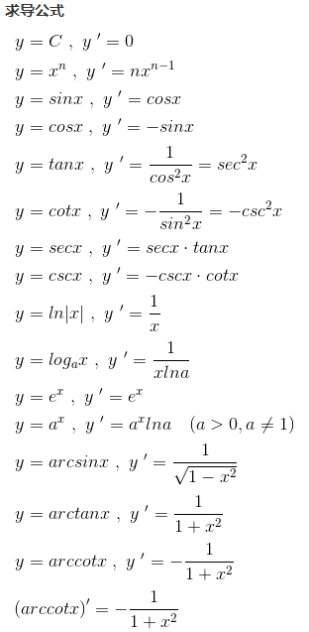


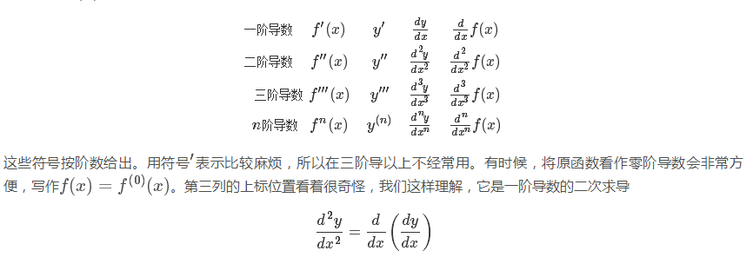

Slide 19

泰勒展开

Slide 20

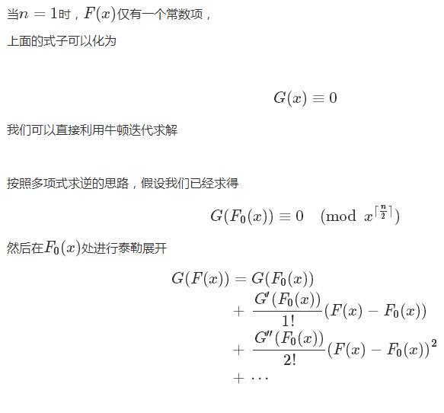
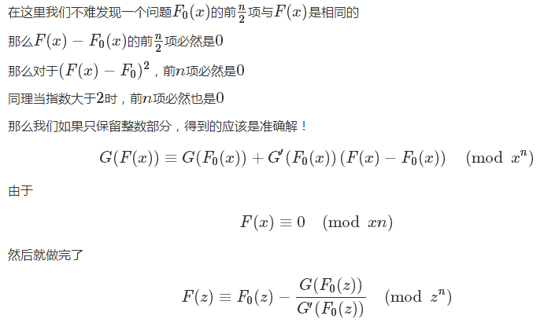
多项式牛顿迭代法

Slide 21
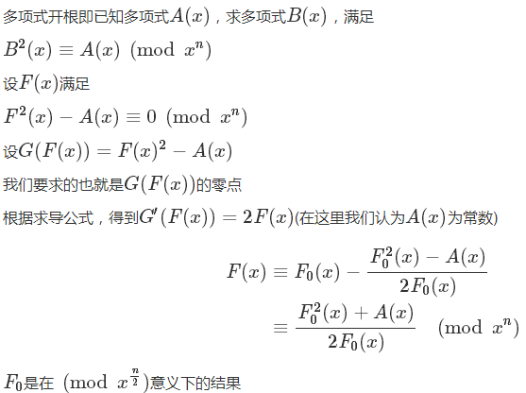
多项式开根

Slide 22
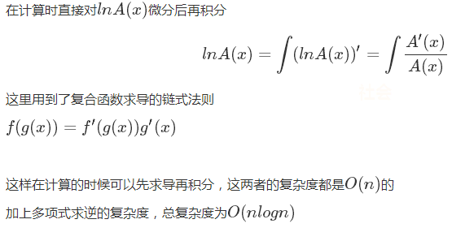
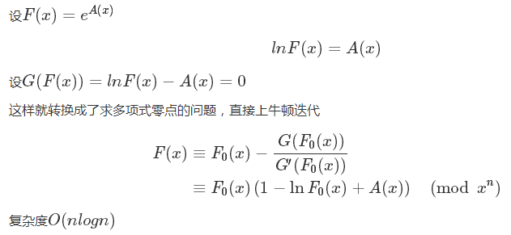
多项式对数与多项式exp

Slide 23
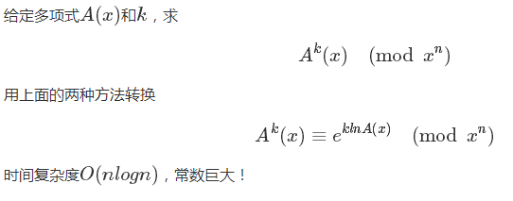
多项式幂函数

Slide 24

多项式三角函数

Slide 25
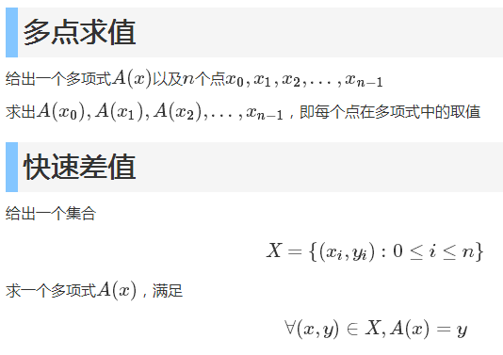
多项式的快速差值与多点求值

Slide 26
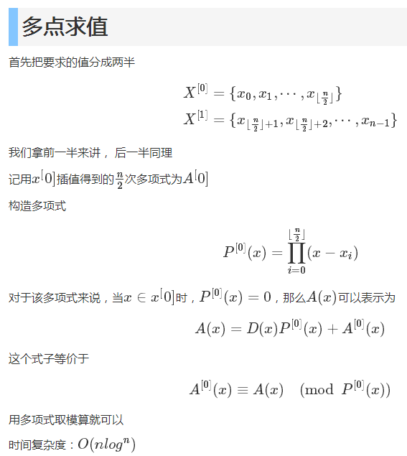

Slide 27
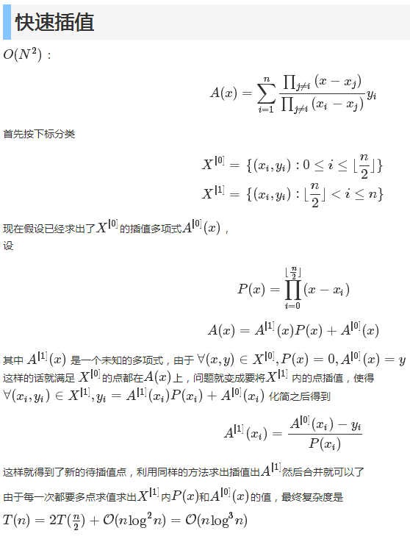

Slide 28
谢谢聆听
THANK YOU FOR YOUR ATTENTION
Notes:
28

